Slide 1
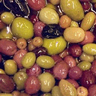
Texture and Texture Classification

Slide 2
Texture
Everyday texture terms - rough, silky, bumpy - refer to touch.
A texture that is rough to touch has:
A large difference between high and low points, and
Silky would have
Little difference between high and low points,

Slide 3
Texture
Texture is characterized by the spatial distribution of gray levels in a neighborhood
Thus, texture cannot be defined for a point
The resolution at which an image is observed determines the scale at which the texture is perceived
In observing an image of a tiled floor from a large distance we observe the texture formed by the placement of tiles, but the patterns within the tiles are not perceived.
When the same scene is observed from a closer distance, so that only a few tiles are within the field of view, we begin to perceive the texture formed by the placement of detailed patterns composing each tile.

Slide 4
Texture
Texture is a description of the spatial arrangement of color or intensities in an image or a selected region of an image
Structural approach: a set of texels in some regular or repeated pattern

Slide 5
Problem with Structural Approach
How do you decide what is a texel?

Slide 6
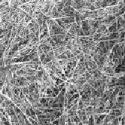
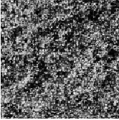
Natural Textures
grass
leaves
What/Where are the texels?

Slide 7
Statistical texture
Segmenting out texels is difficult or impossible in real images.
Numeric quantities or statistics that describe a texture can be
computed from the gray tones (or colors) alone.
This approach is less intuitive, but is computationally efficient.
It can be used for both classification and segmentation.

Slide 8
Texture classification
Classification involves identifying the given textured region from a given set of texture classes.
For example, a particular region in an aerial image may belong to agricultural land, forest region, or an urban area.
Each of these regions has unique texture characteristics.
The texture analysis algorithms extract distinguishing features from each region to facilitate classification of such patterns.
Statistical methods are extensively used in texture classification.

Slide 9
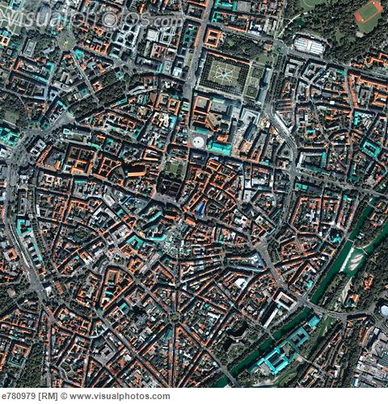
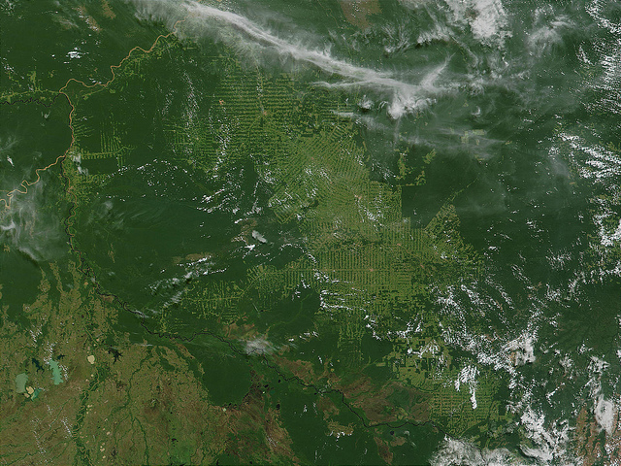
Texture based classification

Slide 10
Statistical methods for texture classification
Since texture is a spatial property, a simple one-dimensional histogram is not useful in characterizing texture
An image in which pixels alternate from black to white in a checkerboard fashion will have the same histogram as an image in which the top half is black and the bottom half is white

Slide 11
Some statistical texture measures
Edge density and direction
Gray level co-occurrence matrices
Local binary patterns

Slide 12
Edge density and direction

Slide 13
Edge density and direction
Use an edge detector as the first step in texture analysis.
The number of edge pixels in a fixed-size region tells us
how busy that region is.
The directions of the edges also help characterize the texture

Slide 14
Two edge-based texture measures
1. Edgeness per unit area
2. Edge magnitude and direction histograms
Fedgeness = |{ p | gradient_magnitude(p) ≥ threshold}| / N
where N is the size of the unit area
Fmagdir = ( Hmagnitude, Hdirection )
where these are the normalized histograms of gradient
magnitudes and gradient directions, respectively.

Slide 15
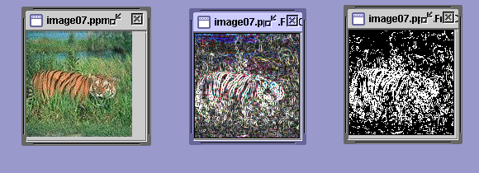
Original Image Edge Image Thresholded
Edge Image

Slide 16
Local Binary Pattern

Slide 17
Local Binary Pattern Measure
For each pixel p, create an 8-bit number b1 b2 b3 b4 b5 b6 b7 b8,
where bi = 0 if neighbor i has value less than or equal to p’s
value and 1 otherwise.
Represent the texture in the image (or a region) by the
histogram of these numbers.
1 2 3
100 101 103
40 50 80
30 60 90
4
5
8
1 1 1 1 1 1 0 0
7 6

Slide 18
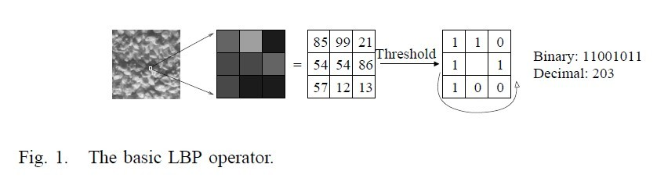
Local Binary Pattern Measure
The histogram of the labels used as a texture descriptor.
The LBP operator was originally designed for texture description. The operator assigns a label to every pixel of an image by thresholding the 3x3-neighborhood of each pixel with the center pixel value and considering the result as a binary number.

Slide 19
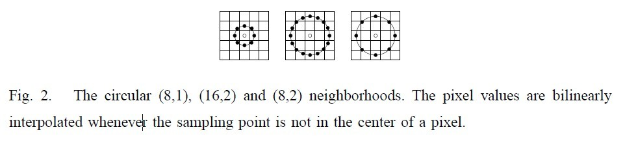
Texture at different scale?
1. Extend LBP operator to use neighborhoods of different sizes.
2. Defining the local neighborhood as a set of sampling points evenly spaced on a circle centered at the pixel to be labeled allows any radius and number of sampling points.
3. If a sampling point does not fall in the center of a pixel using Bilinear interpolation.

Slide 20
Variants of basic lbp
Uniform Pattern: A local binary pattern is called uniform if the binary pattern contains at most two bitwise transitions from 0 to 1 or vice versa when the bit pattern is considered circular
The patterns 00000000 (0 transitions), 01110000 (2 transitions) and 11001111 (2 transitions) are uniform.
The patterns 11001001 (4 transitions) and 01010011 (6 transitions) are not uniform.

Slide 21
Variants of basic lbp
In the computation of the LBP histogram, uniform patterns are used so that the histogram has a separate bin for every uniform pattern and all non-uniform patterns are assigned to a single bin.
It has been shown that with texture images, uniform patterns account for a bit less than 90 % of all patterns when using the (8,1) neighborhood and for around 70 % in the (16,2) neighborhood.

Slide 22

Local binary patterns
Notation for LBP Operator
U2 stands for using only uniform patterns.
The subscript represents using the operator in a (P, R) neighborhood.

Slide 23
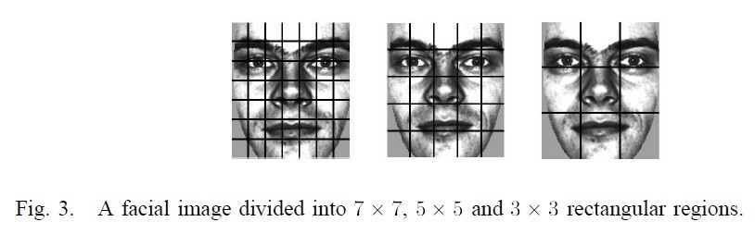
Application of lbp to face recognition
The facial image is divided into local regions and texture descriptors are extracted from each region independently.
The descriptors are then concatenated to form a global description of the face.

Slide 24
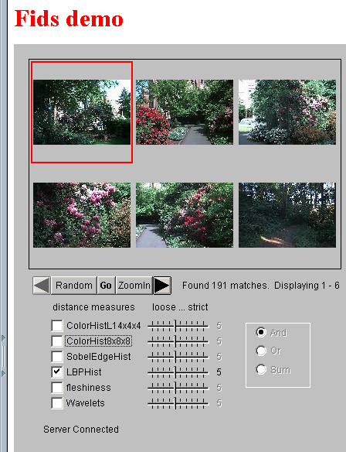
Fids (Flexible Image Database
System) is retrieving images
similar to the query image
using LBP texture as the
texture measure and comparing
their LBP histograms

Slide 25
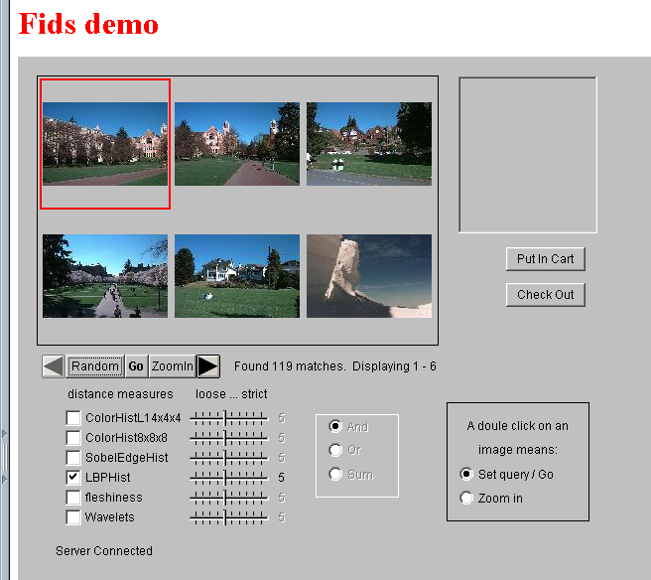
Low-level
measures don’t
always find
semantically
similar images.

Slide 26
Gray level co-occurrence matrix

Slide 27
Gray level co-occurrence matrix
A two-dimensional matrix extensively used in texture analysis
Represents the distribution of co-occurring values at a given offset
The GLCM is created from a gray-scale image
The GLCM calculates how often a pixel with gray-level (grayscale intensity or tone) value i occurs either horizontally, vertically, or diagonally to adjacent pixels with the value j

Slide 28
GLCM Directions of analysis
Horizontal (0 degrees)
Vertical (90 degrees)
Diagonal:
Bottom left to top right (45 degrees)
Top left to bottom right (135 degrees)
Denoted P₀, P₄₅, P₉₀, & P₁₃₅ respectively
Ex. P₀( i , j )

Slide 29
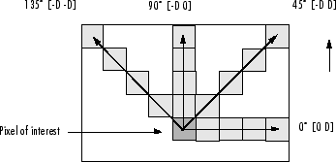
Examples of directional analysis

Slide 30
Order of GLCM
The GLCM described here is used for a series of "second order" texture calculations.
First order texture measures are statistics calculated from the original image values, like variance, and do not consider pixel neighbour relationships.
Second order measures consider the relationship between groups of two (usually neighbouring) pixels in the original image.
Third and higher order textures (considering the relationships among three or more pixels) are theoretically possible but not commonly implemented due to calculation time and interpretation difficulty.

Slide 31
Spatial relationship between pixels
GLCM texture considers the relation between two pixels at a time, called the reference and the neighbour pixel.
If the neighbor pixel is chosen to be the one to the east (right) of each reference pixel, this can be expressed as a (1,0) relation:
1 pixel in the x direction, 0 pixels in the y direction.
Each pixel within the window becomes the reference pixel in turn, starting in the upper left corner and proceeding to the lower right.
Pixels along the right edge have no right hand neighbor, so they are not used for this count.

Slide 32
Separation between two pixels
The examples we see use 1 pixel offset (a reference pixel and its immediate neighbour).
If the window is large enough, using a larger offset is perfectly possible.
Combinations of the grey levels that are possible for the test image, and their position in the matrix

Slide 33
Filling the matrix
Fill in the matrix framework for the east (1,0) spatial relationship:
 | 0 | 1 | 2 | 3
0 | 2 | 2 | 1 | 0
1 | 0 | 2 | 0 | 0
2 | 0 | 0 | 3 | 1
3 | 0 | 0 | 0 | 1
0 | 0 | 1 | 1
0 | 0 | 1 | 1
0 | 2 | 2 | 2
2 | 2 | 3 | 3

Slide 34
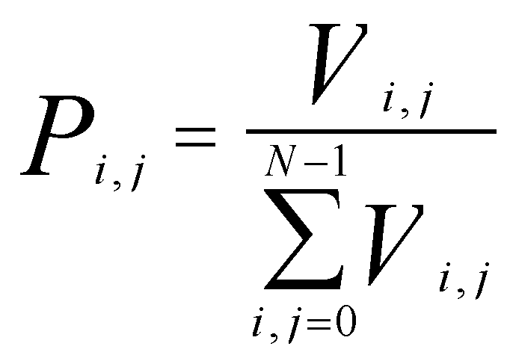
GLCM expressed as probability
The measures require that each GLCM cell contain not a count, but rather a probability.

Slide 35
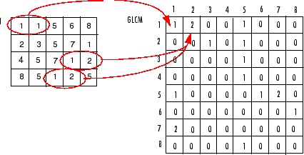
Example Image
GLCM
Image or Sub-Region
P₀(1,2)
P₀(1,1)
P₀(1,3)

Slide 36
General Definition
The gray-level co-occurrence matrix P[i, j] is defined by first specifying a displacement vector d = (dx, dy) and counting all pairs of pixels separated by d having gray levels i and j.

Slide 37
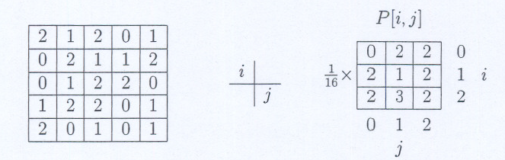
Example
Let the position operator be specified as (1,1), which has the interpretation: one pixel to the right and one pixel below.

Slide 38
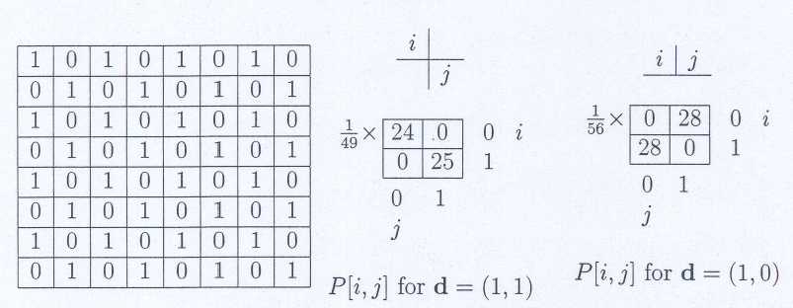
Example
Gray-level co-occurrence matrix captures the spatial distribution of gray levels
Consider the 8 x 8 binary image of a checkerboard

Slide 39
Example
For d = (1,1)
The only pairs that occur are [1,1] and [0,0] because of the well-defined structure of pixels;
The off-diagonal elements are zero.
For d= (1,0),
the only entries will be those corresponding to [0,1] and [1,0]
the diagonal elements are zero.

Slide 40
Statistics from glcm
After you create the GLCMs, you can derive several statistics from them using the different formulas
These statistics provide information about the texture of an image

Slide 41
Statistics from glcm
Most texture calculations are weighted averages of the normalized GLCM cell contents
A weighted average multiplies each value to be used by a factor (a weight) before summing and dividing by the number of values. The weight is intended to express the relative importance of the value

Slide 42
Contrast
To emphasize a large amount of contrast, create weights so that the calculation results in a larger figure when there is great contrast.
Values on the GLCM diagonal show no contrast, and contrast increases away from the diagonal.
Create a weight that increases as distance from the diagonal increases.

Slide 43
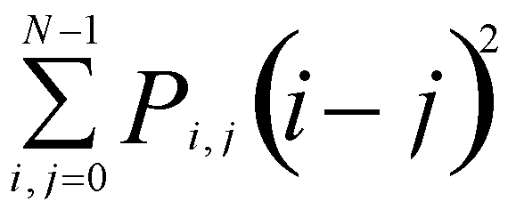
contrast
When i and j are equal, the cell is on the diagonal and (i-j)=0. These values represent pixels entirely similar to their neighbour, so they are given a weight of 0.
If i and j differ by 1, there is a small contrast, and the weight is 1.
If i and j differ by 2, contrast is increasing and the weight is 4.
The weights continue to increase exponentially as (i-j) increases.

Slide 44
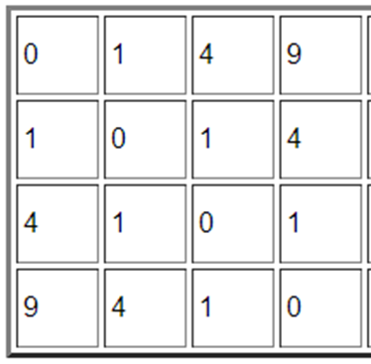
Contrast weights

Slide 45
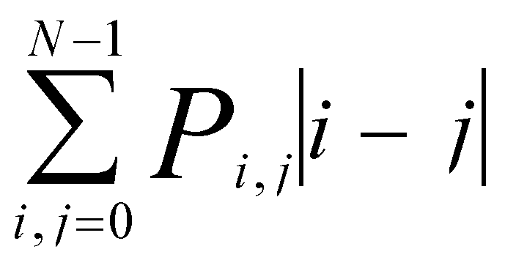
Dissimilarity
In the Contrast measure, weights increase exponentially (0, 1, 4, 9, etc.) as one moves away from the diagonal. However in the dissimilarity measure weights increase linearly (0, 1, 2,3 etc.).

Slide 46
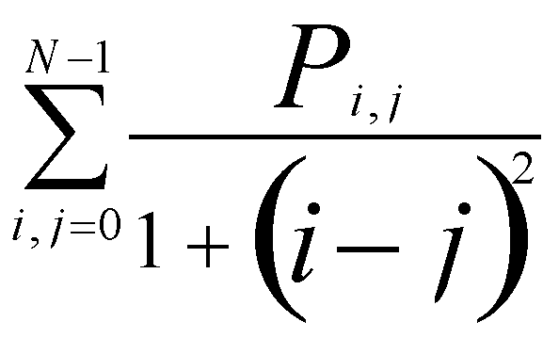
Homogeneity
Homogeneity weights values by the inverse of the Contrast weight, with weights decreasing exponentially away from the diagonal:

Slide 47
Creating texture image
Texture measures can be computed using a sliding window
The result of a texture calculation is a single number representing the entire window. This number is put in the place of the centre pixel of the window
The window is then moved one pixel and the process is repeated of calculating a new GLCM and a new texture measure

Slide 48
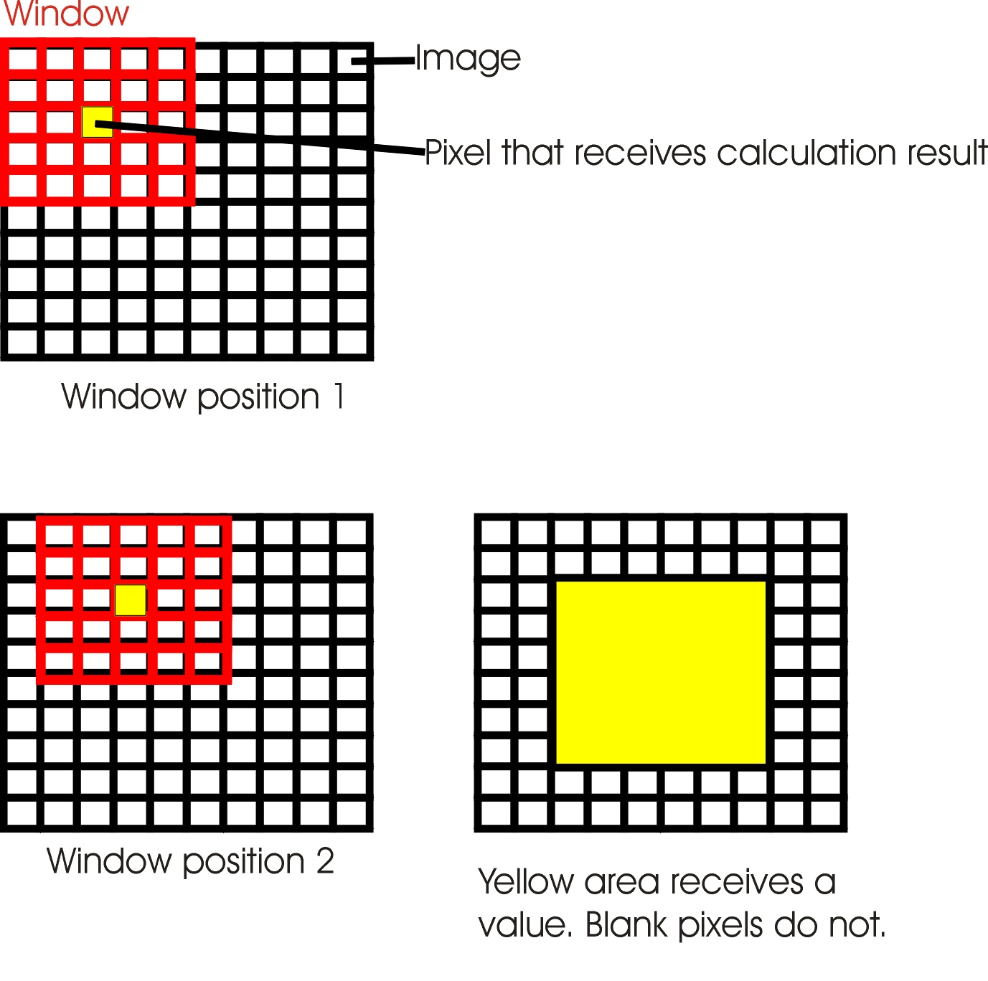
Creating texture image

Slide 49
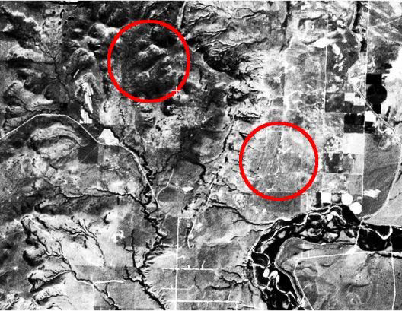
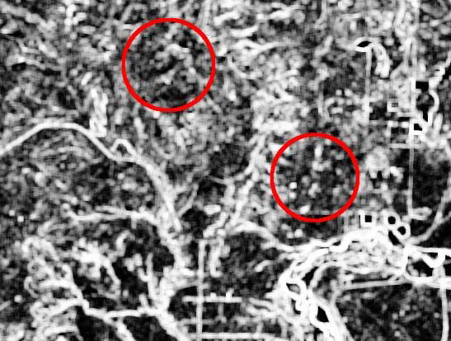
GLCM Contr
Original Image
GLCM Contrast

Slide 50
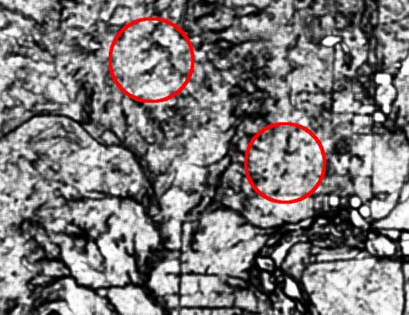
Original Image
GLCM Homogenity

Slide 51
Observations from glcm
The diagonal elements all represent pixel pairs with no grey level difference (0-0, 1-1, 2-2, 3-3 etc.). If there are high probabilities in these elements, then the image does not show much contrast: most pixels are identical to their neighbours.
When values in the diagonal are summed, the result is the probability of any pixel's being the same grey level as its neighbour.

Slide 52
Observations from glcm
Lines parallel to the diagonal: Cells one cell away from the diagonal represent pixel pairs with a difference of only one grey level (0-1, 1-2, 2-3 etc.).
Similarly, values in cells two away from the diagonal show how many pixels have 2 grey level differences, and so forth.
The farther away from the diagonal, the greater the difference between pixel grey levels.
Sum up these parallel diagonals and the result is the probability of any pixel's being 1 or 2 or 3 etc. different from its neighbour.

Slide 53
Larger matrices
Eight bit data has 256 possible values, so would yield a 256 x 256 square matrix, with 65,536 cells
Some operational programs rescale the values into 4 bit (16 x 16 matrix with 256 cells)

Slide 54
Larger matrices
If all 256 x 256 cells are used, there would be many cells filled with zeros
The GLCM approximates the joint probability distribution of two pixels. Having many zeros in cells makes this a very bad approximation.
If the number of grey levels is reduced, the number of zeros is reduced, and the statistical validity is greatly improved.

Slide 55
References
web.pdx.edu/~jduh/.../Hayes_GreyScaleCoOccurrenceMatrix.pdf
http://www.fp.ucalgary.ca/mhallbey/tutorial.htm
Chad Carson, Serge Belongie, Hayit Greenspan, and Jitendra Malik. "Blobworld: Image Segmentation Using Expectation-Maximization and Its Application to Image Querying." IEEE Transactions on Pattern Analysis and Machine Intelligence 2002; Vol 24. pp. 1026-38.
W. Forstner, “A Framework for Low Level Feature Extraction,”
Proc. European Conf. Computer Vision, pp. 383-394, 1994
Face Description with Local Binary Patterns: Application to Face Recognition, Lingfeng Mo

